Slide 1
Covered in “P” David Foster Wallace’s Paratextual Curse
Tore Rye Andersen
Aarhus University, Denmark

Slide 2
Jenni B. Baker: Erasing Infinite

Slide 3
Found poetry from the paratexts of Infinite Jest:
Pynchon,
Pynchon,
Thomas Pynchon

Slide 4
Found poetry from the paratexts of Infinite Jest:
Pynchon,
Gravity’s Rainbow,
Pynchon

Slide 5
Found poetry from the paratexts of Infinite Jest:
Pynchon,
Gravity’s Rainbow,
Pynchon,
Thomas Pynchon

Slide 6
For us, the paratext is what enables a text to become a book and to be offered as such to its readers. More than a boundary or a sealed border, the paratext is, rather, a threshold, or [...] a “vestibule” that offers the world at large the possibility of either stepping inside or turning back. It is an “undefined zone” between the inside and the outside, or a fringe of the printed text which in reality controls one’s whole reading of the text.
(Gérard Genette: Paratexts)

Slide 7
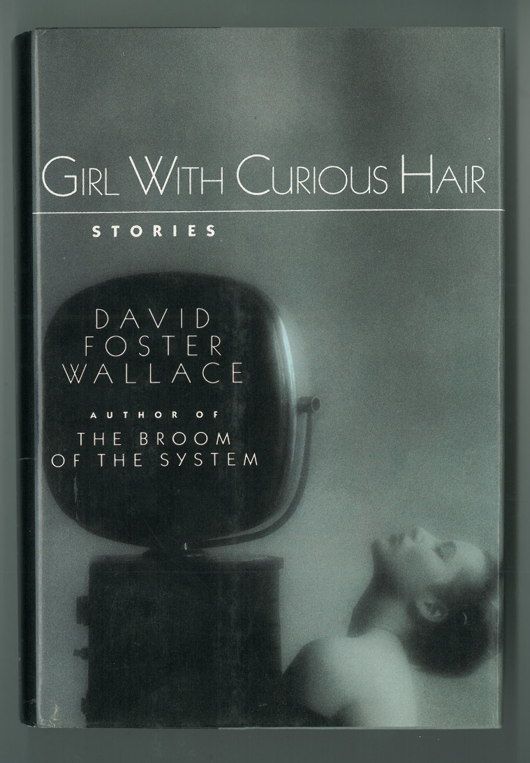
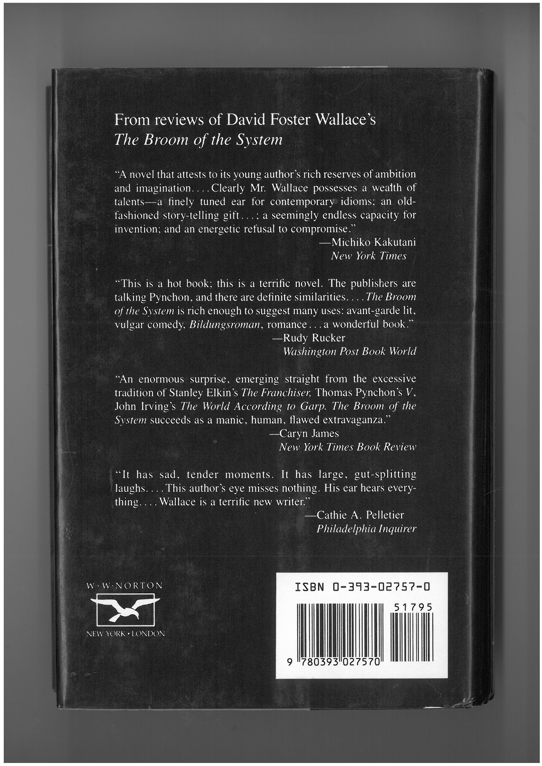

Slide 8
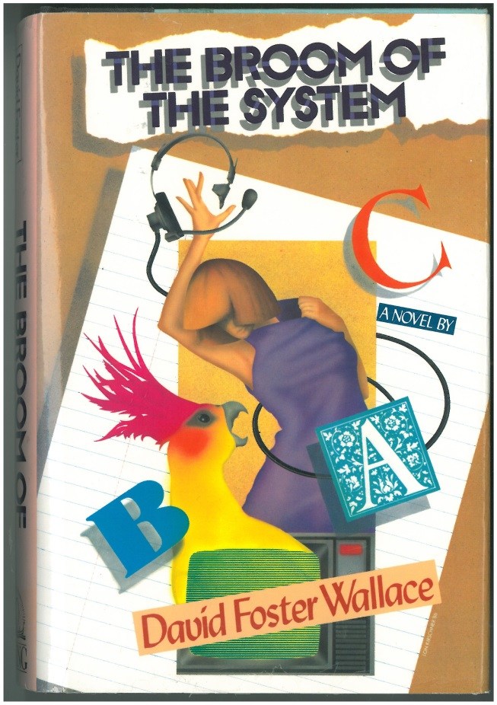
From its opening pages onward through its enigmatic ending, The Broom of the System will remind readers of The Crying of Lot 49 by Thomas Pynchon. (From Michiko Kakutani’s review)

Slide 9
The first book that I wrote, The Broom of the System, some reviewer for the New York Times [Kakutani] said it was a rip-off of The Crying of Lot 49, that I hadn’t read yet. So I got all pissed.
(Wallace on Kakutani’s review)

Slide 10
The inventiveness, reach, and fine disdain for ‘reality’ of this novel will remind many readers of the work of John Irving, Vladimir Nabokov, John Barth, and especially the Thomas Pynchon of The Crying of Lot 49. (From Viking’s description of The Broom of the System)

Slide 11
The inventiveness, reach, and fine disdain for ‘reality’ of this novel will remind many readers of the work of John Irving, Vladimir Nabokov, John Barth, and especially the Thomas Pynchon of The Crying of Lot 49.
(From Viking’s description of The Broom of the System)
From its opening pages onward through its enigmatic ending, The Broom of the System will remind readers of The Crying of Lot 49 by Thomas Pynchon.
(From Michiko Kakutani’s review)

Slide 12
I bristle sometimes at getting compared to some older – like some of these classic postmodern guys. The – the – the “P” guy comes into mind. I won’t even say his name.
(David Foster Wallace to Tom Vitale in 1997)

Slide 13
Thank you!

